Slide 1
Unit 7: Buying or Renting a Home

Slide 2
Preview the topic
What do you know about how to rent an apartment or home?

Slide 3
Renting a Home or Apartment
Cons
Rent payments do not build equity or wealth.
Rents can increase.
Pros
Renting provides a place to live without having a large amount of cash.
Good option until your income increases enough to purchase a home.

Slide 4
How much Rent Can You afford?
Begin with your net income
Deduct these costs:
Current bills
Utilities (gas, electricity, water)
Food
Entertainment

Slide 5
Reduce your costs by sharing with a roommate
Think, Pair, Share
How would you choose a good roommate?

Slide 6
Selecting a good roommate
To make the rent more affordable, consider splitting costs with a roommate. To select a good roommate, ask these questions:
Are you a smoker?
Do you have pets or want one?
Do you have allergies?
What is your daily schedule? Are you a day person or a night person?
How important is it to you to pay the rent on time?
Do you know how to cook?
What do you do on the weekends?
What do you think of overnight guests?
What are your pet peeves?

Slide 7
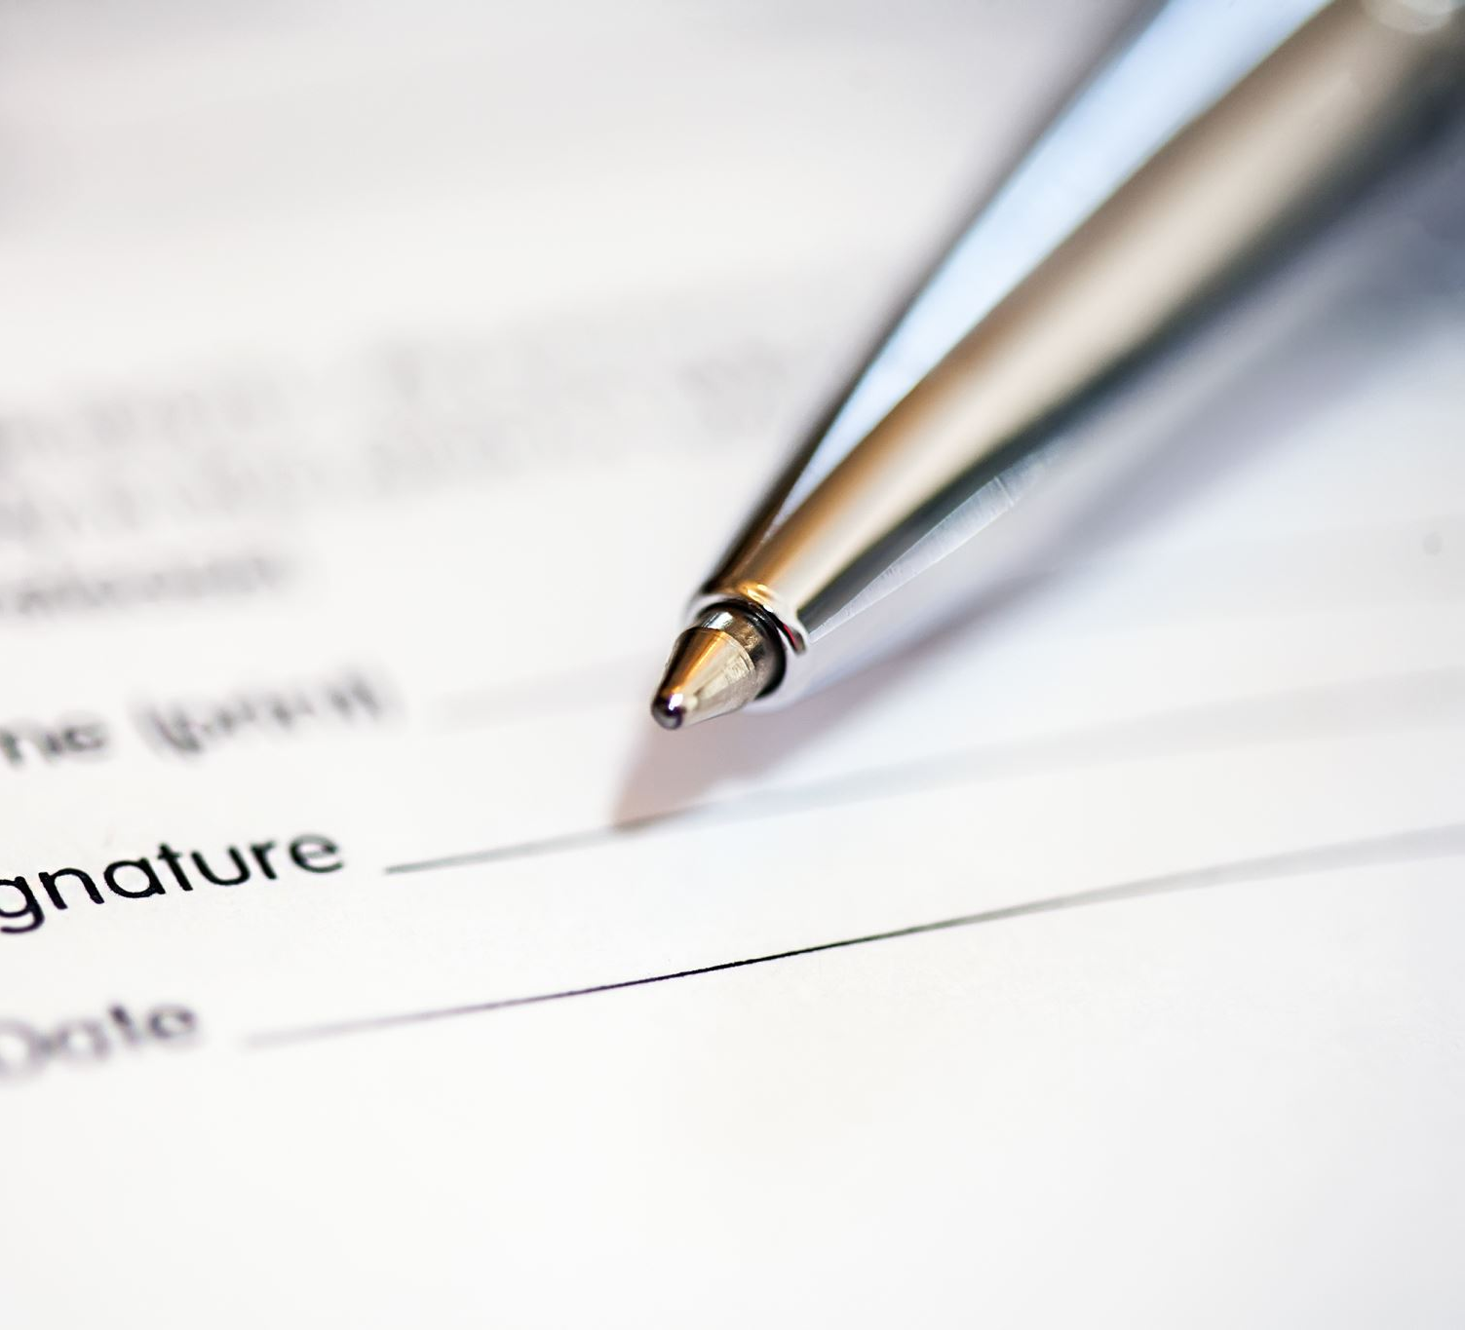
Sign a lease
A lease is a rental agreement for a specified time.
Be sure to read and understand the terms of the lease.

Slide 8
Requirements for renting
Good credit report
Security Deposit
First and last months rent
References?

Slide 10
Group Discussion
What are the advantages of owning your own home?

Slide 11
Advantages of Owning a home
Stable housing costs. No rising rents.
Appreciating asset. Value increases over time.
Build equity. The down payment and appreciation are assets.
A source of cash for home improvements and paying debt.
Tax advantages. Deduct mortgage interest and property taxes.
Build your credit.
The freedom to personalize your home.

Slide 12
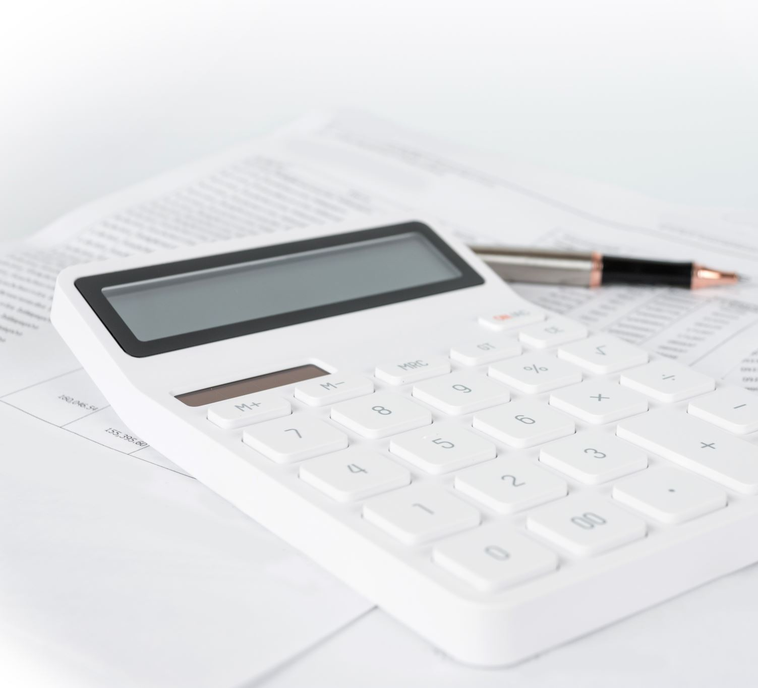
Getting Ready to purchase a home
Maintain steady employment for at least two years.
Save money for the down payment and closing costs.
Maintain a good credit score (above 620)
Prepare a budget to determine if you can afford the mortgage and home expenses

Slide 13
Some Real estate vocabulary
Mortgage
A loan to purchase a home
Debt-to-Income Ratio
What percent of your income goes to pay off debt? It should be less than 43%.

Slide 14
How much cash do I need?
Down payment
Generally, about 3% of the home value.
There are some no down payment options, but the interest rate is higher
Closing costs are fees for creating your loan
Can be paid by the seller or included in your mortgage

Slide 15
Credit Score
Your credit score is based on your repayment history.
Generally, you will need a credit score of 620 to qualify for a loan
A score of 720 or higher will get you the best interest rate

Slide 16
How much can I afford for the monthly payment?
Consider
Income
Debts
Expenses
Property taxes
Insurance
Money for maintenance and repairs

Slide 17
Interest rates
Fixed-rate Mortgages
The interest does not change throughout the life of the loan.
The advantage is a consistent loan payment that does not change.
The disadvantage is that the interest rate can be higher than an adjustable-rate loan.
Adjustable-rate Mortgages (ARM)
The interest is variable and can be raised or lowered.
The advantage is a lower interest rate.
The disadvantage is that your payment can increase.

Slide 18
Types of Loans
Conventional Loans are the most common. They are made by private lenders. The down payment is around 3%.
FHA Loans are backed by the Federal Housing Administration and insured by the government. Down payments are around 3.5%.
VA Loans are for veterans and members of the Armed Forces and insured by the Department of Veterans Affairs. No down payment is required.
USDA Loans are government insured loans for rural and suburban areas.
Get pre-approved for a loan before shopping for a home.

Slide 19
First Step: The Real Estate Agent
Represents you
Familiar with the local market
Assists in showing the property, writing offers, and negotiations
Fee generally paid by the seller

Slide 20
Requirements
Inspection
Are there problems with the home?
Appraisal
How much is the home worth?

Slide 21
Closing the Deal
The Closing Disclosure Statement
How much is due at closing?
What is the interest rate?
What is the cost of the loan?
What is my monthly payment?
What is the estimate for taxes and insurance?

Slide 23
Summary: Important Steps
Have
Have a good credit score. Aim for 740 or higher.
Need
You will need 2 years of consistent income. Provide tax returns.
Save
Save money for reserves.
Calculate
Calculate the down payment and closing costs.
Save
Save money for a down payment.

Slide 24
One Minute Paper
Imagine yourself 20 years from now. What type of home do you have? Are you renting or do you own this home?
Underline your best sentence. Share it with the class.

